Slide 1



Customer Personality Analysis

Slide 2

Table of Contents
2
Data Cleaning
4
5
6
1
Problem Statement
Dataset Attributes
3
Visualization
Insight
Recommendations

Slide 3
Problem Statement
Customer Personality Analysis is a detailed analysis of a company’s ideal customers. It helps a business to better understand its customers and makes it easier for them to modify products according to the specific needs, behaviors and concerns of different types of customers.
Customer personality analysis helps a business to modify its product based on its target customers from different types of customer segments. For example, instead of spending money to market a new product to every customer in the company’s database, a company can analyze which customer segment is most likely to buy the product and then market the product only on that particular segment.

Slide 4
Dataset Attributes
People
ID: Customer's unique identifier
Year_Birth: Customer's birth year
Education: Customer's education level
Marital_Status: Customer's marital status
Income: Customer's yearly household income
Kidhome: Number of children in customer's household
Teenhome: Number of teenagers in customer's household
Dt_Customer: Date of customer's enrollment with the company
Recency: Number of days since customer's last purchase
Complain: 1 if the customer complained in the last 2 years, 0 otherwise
Products
MntWines: Amount spent on wine in last 2 years
MntFruits: Amount spent on fruits in last 2 years
MntMeatProducts: Amount spent on meat in last 2 years
MntFishProducts: Amount spent on fish in last 2 years
MntSweetProducts: Amount spent on sweets in last 2 years
MntGoldProds: Amount spent on gold in last 2 years

Slide 5
Dataset Attributes
Promotion
NumDealsPurchases: Number of purchases made with a discount
AcceptedCmp1: 1 if customer accepted the offer in the 1st campaign, 0 otherwise
AcceptedCmp2: 1 if customer accepted the offer in the 2nd campaign, 0 otherwise
AcceptedCmp3: 1 if customer accepted the offer in the 3rd campaign, 0 otherwise
AcceptedCmp4: 1 if customer accepted the offer in the 4th campaign, 0 otherwise
AcceptedCmp5: 1 if customer accepted the offer in the 5th campaign, 0 otherwise
Response: 1 if customer accepted the offer in the last campaign, 0 otherwise
Place
NumWebPurchases: Number of purchases made through the company’s website
NumCatalogPurchases: Number of purchases made using a catalogue
NumStorePurchases: Number of purchases made directly in stores
NumWebVisitsMonth: Number of visits to company’s website in the last month

Slide 6
Data Cleaning
To space out each piece of data into its own column in Microsoft Excel, I utilize the text to column function.
Make all of the data attributes uppercase.
Assign the appropriate data types to the columns.
To help with the analysis, an age group was introduced.
Change the value of the complain and response properties to "True" for 1 and "False" for 0.
Remove any missing rows and outliers.
I have 2216 rows and 23 columns for analysis out of the dataset's 2240 rows and 29 columns after cleaning the data.

Slide 7
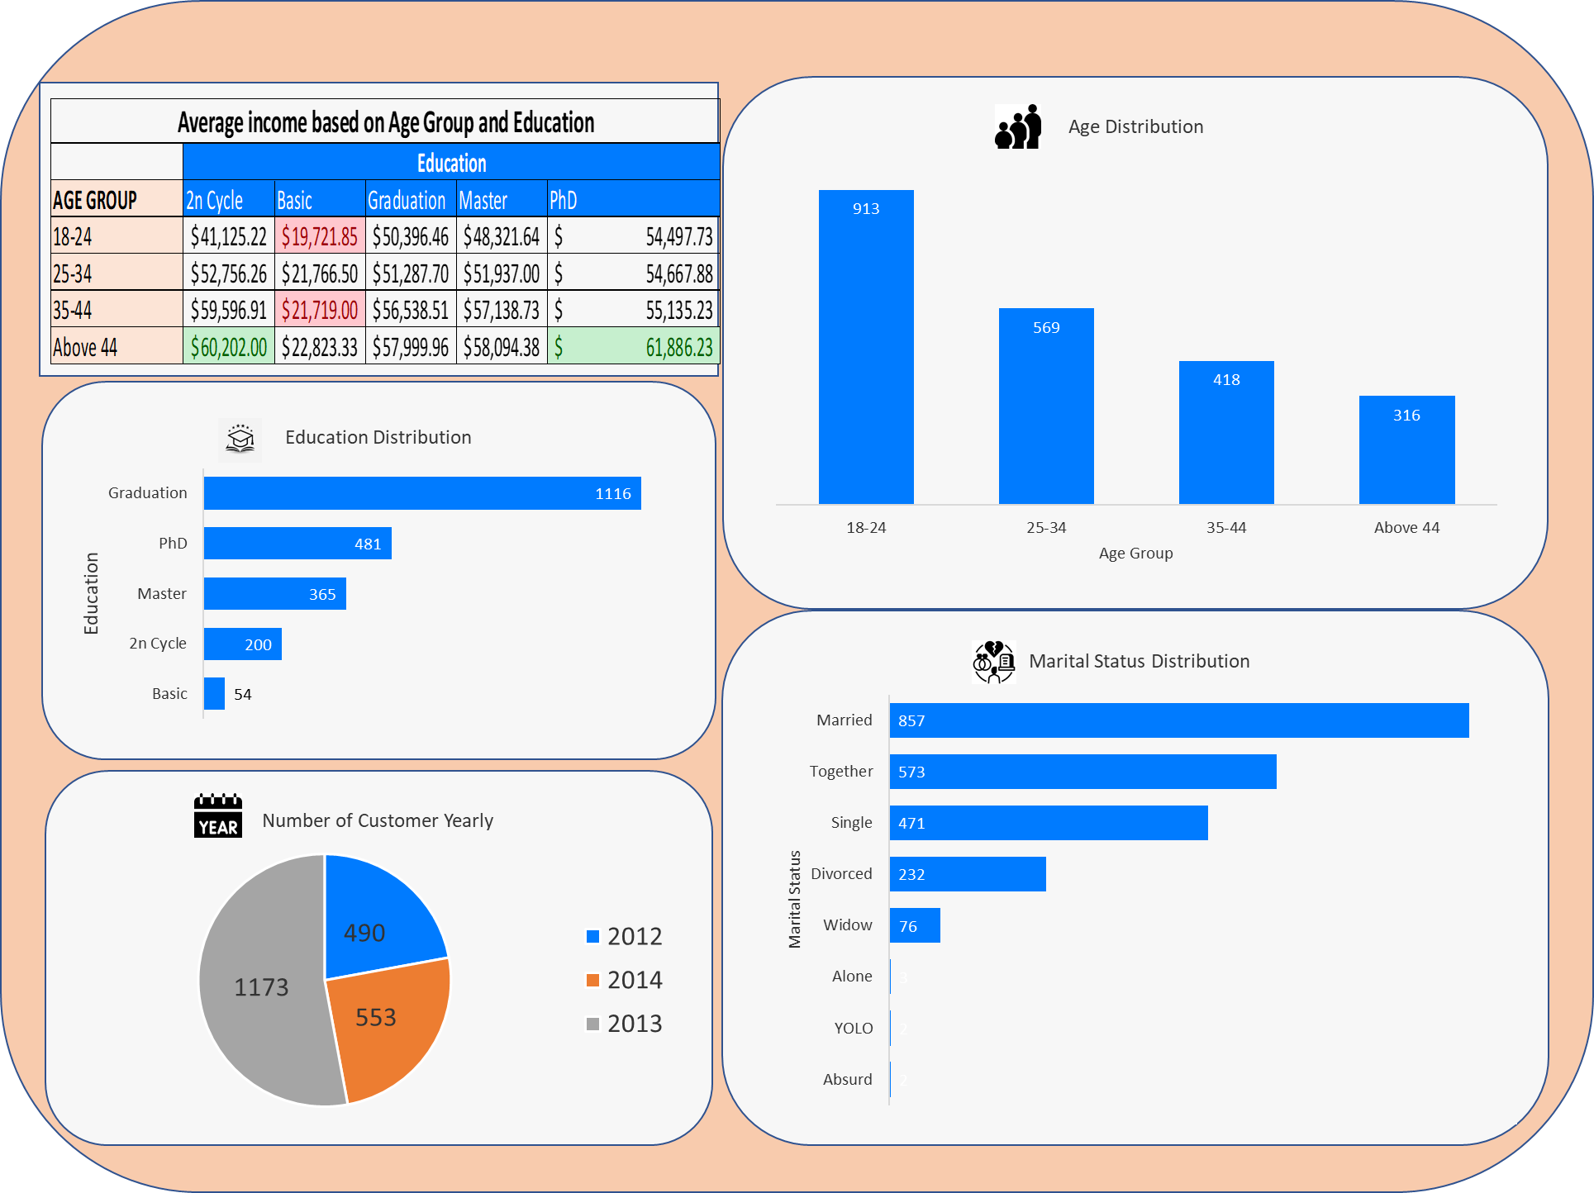
Visualization: Demographic

Slide 8
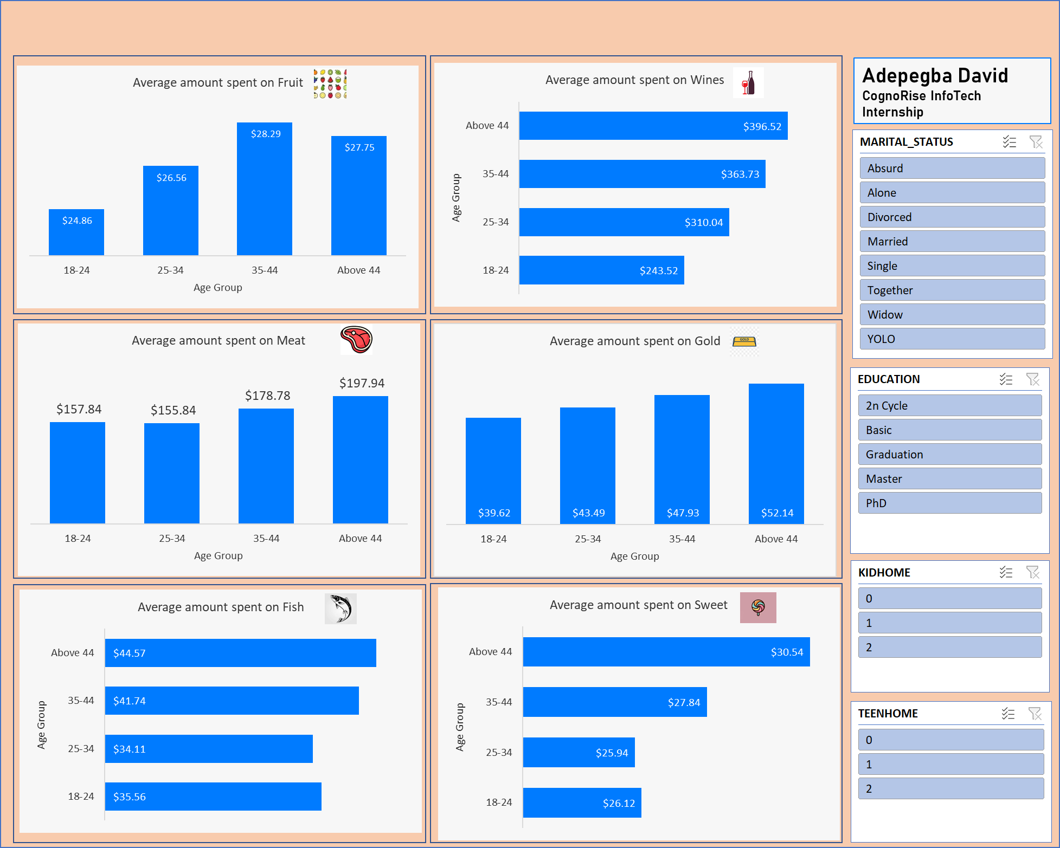
Visualization: Products

Slide 9
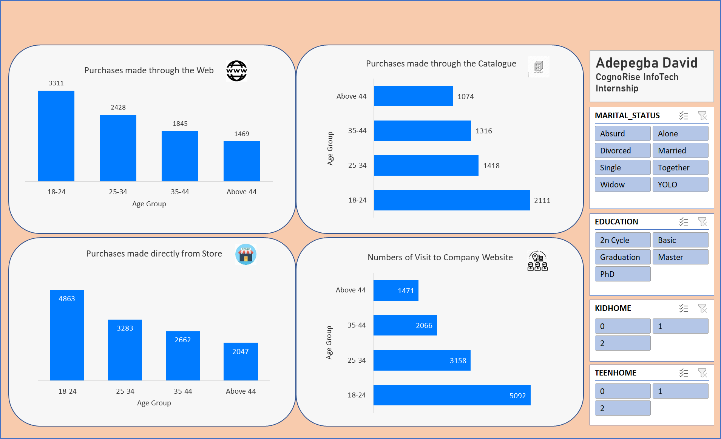
Visualization: Purchases

Slide 10
Insights
Here are some conclusions drawn from the Demographic Dashboard:
The majority of clients are between the ages of 18-24 years old.
Customers who are married dominate the company's dataset.
In terms of education level, graduate customers likewise predominate the dataset.
When it comes to clients joining the dataset, the organization had the most in 2013.
Here are some insights gleaned from the product dashboard:
The category with the highest average spending is wine ($396.52), which is consumed by people over 44.
Fruit goods have the lowest average cost ($24.86) among people aged 18 to 24.
After wine, shoppers love to buy meat as their next favorite product.
Purchases dashboard Analysis:
18-24 years old often visit the company website to check for the latest product available.
Purchases made from the store has the highest number where customer would love to purchase the product with the age group 18-24 has the highest number.
Purchase made through the catalogue has the lowest way in which customer do purchase where above 44 has the lowest value of 1074.

Slide 11
Recommendations
To optimize product development and marketing strategies, I recommend that the company focuses on the following:
Targeted marketing: Concentrate marketing efforts on the dominant customer segments: married individuals, graduates, and those aged 18-24.
Product development: Develop products catering to the preferences of the highest spending categories: wine (for customers over 44) and meat (for customers of all ages).
Age-specific products: Introduce products tailored to the specific needs of different age groups, such as fruit products for customers aged 18-24.
Online presence: Enhance the website to attract more visitors, particularly those aged 18-24, who frequently check for new products online.
Omnichannel sales: Optimize sales across all channels, with a focus on in-store purchases, which are the most popular among customers.
Catalogue optimization: Revamp the catalogue to appeal to customers over 44, who showed the lowest interest in catalogue purchases.
By implementing these recommendations, the company can effectively modify its products and marketing strategies to meet the specific needs and preferences of its target customer segments, leading to increased customer satisfaction and business growth.

Slide 12


